Slide 1
Demographic Scenario(2021-2041) and How to get dividend through TVET (M-01.01)
By
Dr. Sheikh Abu Reza
Former Director (P&D), DTE &
CBT&A Trainer

Slide 2
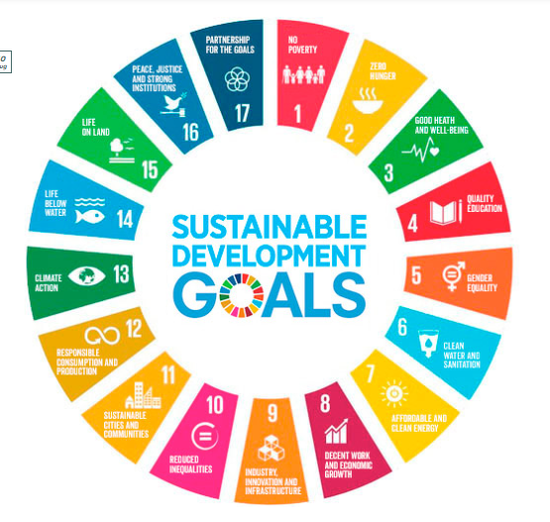

Slide 3
SDGs by 2030-2041
Economic growth of last ten years of Bangladesh:
At a particular stage of development at the moment.
The government is committed to implementing the SDGs by 2030 and become a middle income country.
Working to achieve the national collective goal to the list of developed countries in 2041.

Slide 4
New Development Agenda
The implementation and success of Agenda 2030, the new development agenda to guide the world, will depend largely on the demographic changes taking place over the next 15 years and beyond. These changes will create both opportunities and challenges. One of the biggest challenges will be how to adjust to an unprecedented world population of 8.4 billion by 2030 while also ensuring a more equitable and inclusive pattern of economic growth and sustainable development for all.

Slide 5
Demographic Window of Opportunity
Globally, the number of young people is at an all-time high. As mortality and fertility decline, countries typically enjoy a period when the ratio of working-age population to both young and old dependents, rises.
This provides a one-time “demographic window of opportunity” before the dependency ratio rises again with the growth of the elderly population; however, it is not automatic or guaranteed that this one-time demographic window of opportunity will actually lead to a “demographic dividend”.

Slide 6
Country Invests
It will turn into a demographic dividend only if the country invests heavily now in health, education, skills development, and employment generation, especially for the adolescents and youth. Advancing gender equality and women’s empowerment is another key component that requires special attention in Bangladesh.

Slide 7
Visionary Action Plan
With such prospects of growth, the entire financial sector need to adopt a visionary action plan. Not only sound education but alertness and dedication too are most required. In other words, far-reaching ideas, plans, initiatives and priority sector-based investments are needed to move the country's economy forward. With this investment, the working people of the country can make the wheel of the country's economy more dynamic in the fastest time with their labour and talent. And a huge opportunity for us is the demographic dividend.

Slide 8
Demographic Dividend
More specifically, the demographic “dividend” will be harnessed if three conditions are met. First, improvements in health status, especially children’s and women’s health, will contribute both to improved child survival and a decrease in the number of children born to each family in successive cohorts, thus accentuating the population bulge in the cohorts now entering or about to enter the working ages. Second, those in these large cohorts and the smaller cohorts that follow them will benefit from investment in education and health.

Slide 9
4 benefits to a demographic dividend:
If the number of working people is greater than the number of non-working people, then it is a demographic dividend. According to economists, there are four benefits to a demographic dividend:
Improving labour supply,
Growth of savings
Human capital and
Domestic market expansion.

Slide 10
By 2040 - Bangladesh's economic growth
These four benefits can be ensured if this functional youth force can be harnessed.
This demographic dividend period lasts a maximum of 20-30 years in a country.
In other words, by 2040, the opportunity to achieve Bangladesh's economic growth at lightning speed by utilising the demographic dividend will begin to decline.
At present, the number of working people in our country is about 65 per cent of the total population.
The number of working people in Bangladesh is now 106.1 million (10 crore 61 lakh).
Of this, the actual labour force is 62.1 million (59.5 million working in the public and private sectors, the remaining 2.6 million are still fully unemployed, and 44.0 million are completely unemployed).

Slide 11
Time to boost the country's economy
Therefore, now is the time to boost the country's economy by engaging this working population in productive socio-economic activities.
China, South Korea, Vietnam, Taiwan and Thailand, for example, have taken their economic position to new heights through the effective use of demographic dividends.
If the benefits of the demographic dividend can be realized, then as Bangladesh's per capita income increases, more people will be economically active and their savings will increase.

Slide 12
Appropriate use of Demographic Dividend.
The garment sector is still the main source of export earnings in Bangladesh (86.0 per cent).
At present, rapid investment is required in various sectors including information and communication technology sector, light engineering sector, tourism and hospitality, agriculture and service industries.
If this functional youth group of the country can be trained in these sectors through long-term planned training, then these trained youth groups will be able to establish their position in the country and in the international arena.
And in the near future, Bangladesh will be a middle-income country and will be far ahead in the list of developed countries in 2041.

Slide 13
CBT&A Courses
Sector
Occupation
Level

Slide 14

Best Wishes to All

